Slide 1

Maryland Association of Counties
Winter Conference
Friday, January 4, 2013

Slide 2
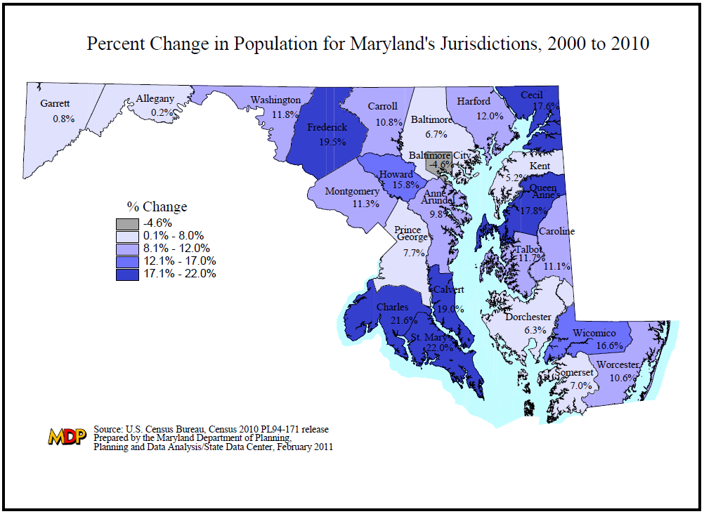

Slide 3
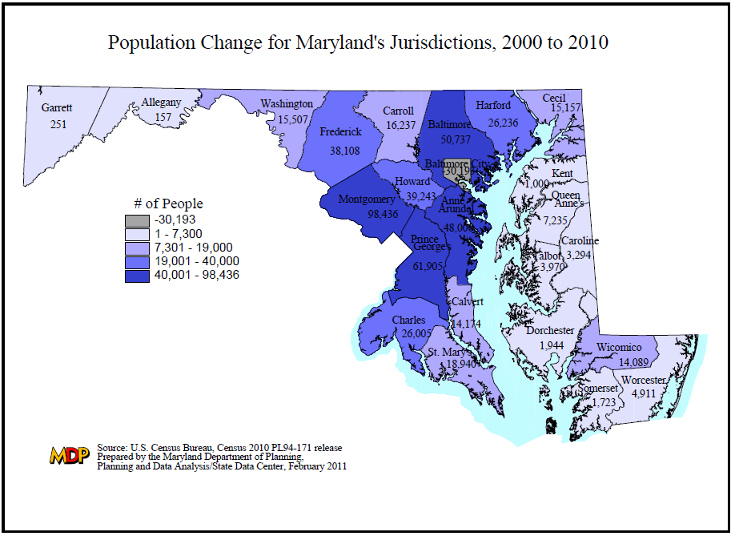

Slide 4
Population Change for Maryland’s Jurisdictions,
2000 to 2010
Source: U.S. Census Bureau, Census 2000 and 2010 PL94-171 release
Prepared by the Maryland Department of Planning, February 2011

Slide 6
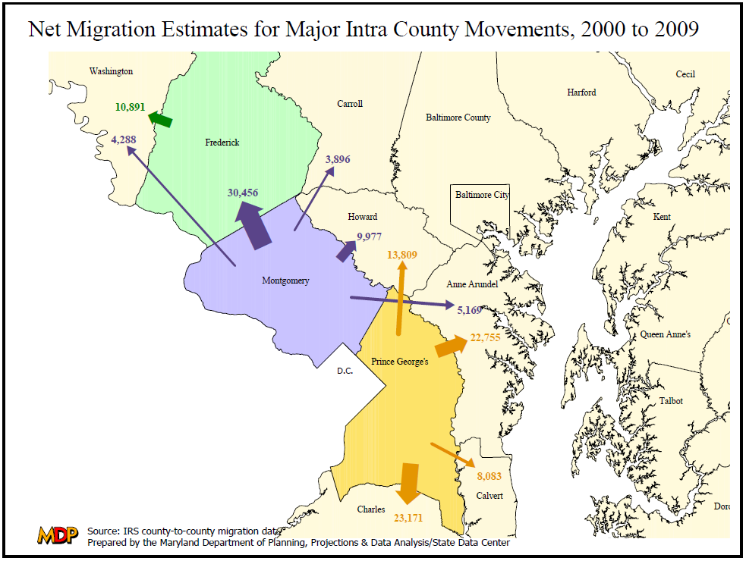

Slide 7
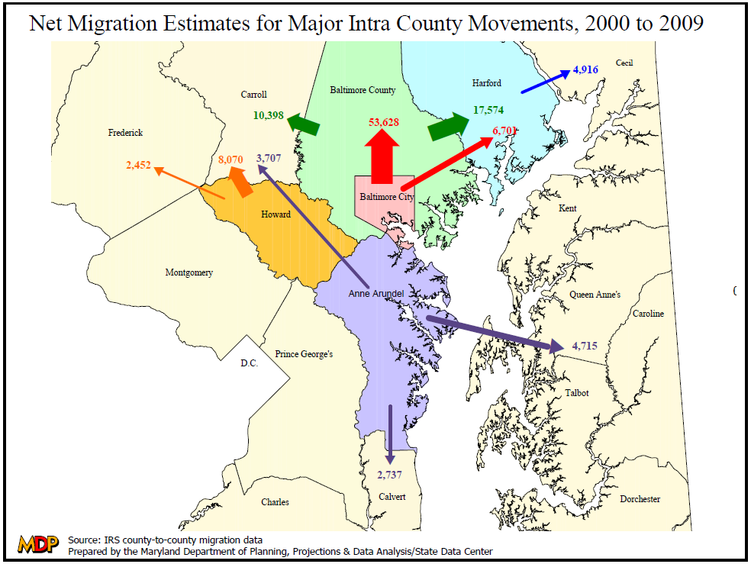

Slide 8
Median Household Income
Calendar Years (2008 – 2010)
Notes:
*State Employee is just the median salary for one state employee (not household).

Slide 9
2013 Local Tax Rate

Slide 10
Real Property Tax Rate

Slide 11
State Aid by Government Entity
Amount and Percent of Total State Funds
($ in Millions)
 | FY 2014 State Aid Amount | Percent of Total
Public Schools | $6,008.1 | 86.7%
County/Municipal | 509.1 | 7.3%
Community Colleges | 302.2 | 4.4%
Libraries | 70.2 | 1.0%
Local Health | 38.2 | 0.6%
Total | $6,927.9 | 100%
Annual State Revenues - $15 billion

Slide 12
The State provides 52.1% of all K-12 Education operating funds
Notes:
In 2009, state funding was 49.9% and has risen to 52.1% in 2012

Slide 13
The State pays on average 64% of eligible school construction costs

Slide 14
Statewide School Construction Investment
FY 2006 – FY 2013

Slide 15
TOTAL = $2.4 Billion
Notes:
Western Maryland (Allegany, Garrett, Washington, Carroll)
Southern Maryland (Charles, St. Mary’s, Calvert)

Slide 16
State School Construction Expenditures for Montgomery County
Per Capita Comparison (FY06 – FY13)
2.3x
$731
Per Capita

Slide 17
Delegates Voting for Revenue and Budget Bills
(Including operating and capital budgets FY 2010 – FY 2013)
Notes:
Southern Maryland (Charles, St. Mary’s, Calvert)
Western MD (Allegany, Garrett, Washington, Frederick, Carroll)

